Slide 1
Avinashilingam Institute for Home Science & Higher Education for Women (Deemed to be
University under Category ‘A’ by MHRD, Estd. u/s 3 of UGC Act 1956)
Re-accredited with ‘A++’ Grade by NAAC. Recognised by UGC Under Section 12B Coimbatore –
641043, Tamil Nadu, India
SCHOOLOF ENGINEERING
DEPARTMENT OF COMPUTER SCIENCE AND ENGINEERING
LOST NO MORE USING AI
PRESENTED BY
Asvika N (21009UEA03)
Avanthika K S (21012UEA05)
Harshini AV S (21037UEA09)
Raga Nitharsana C (21093UEA16)
GUIDED BY
Dr.P.AMUDHA
Professor, CSE

Slide 2
OVERVIEW
Literature survey
Problem statement
Objective
Introduction
Proposed system
Technical specifications
Methodology
Conclusion

Slide 3
LITERATURE SURVEY
S.no | Title | Author(s) & Year | Methodology | Remarks
1. | Missing Person Detection System in IoT | Digambar Jadhav et al. 2017 | Uses IoT sensors for real-time location tracking and image capture; integrates with local police. | IoT- based approach; lacks direct video analysis capability.
2. | Finding Missing Person Using Artificial Intelligence | A. Ponmalar et al. 2022 | Uses face recognition algorithms to match uploaded images with those in a database. Notifications are sent if a match is found. | Limited to face recognition; requires extensive database.
3. | IoT Smart Tracking Device for Missing Person Finder | R. Brinda et al. 2022 | Utilizes GPS and GSM for real-time tracking; data stored on a web server; multiple user roles for data management. | Relies on GPS/GSM, not focused on video- based searches.

Slide 4
LITERATURE SURVEY Contd...
4. | Identification of Missing Person Using Convolutional Neural Networks | P.D N Harsha Sai et al. 2022 | Uses VGG16 CNN for face recognition; preprocesses and augments data for training. | Accuracy dependent on data quality; CNN models can be resource- intensive.
5. | Detection of Missing Persons Using Mobile App | Mohan Datta Inavolu et al. 2023 | App interface for entering missing person data; searches using name, age, etc.; includes call and share features. | Not specifically focused on video analysis; depends on user database.

Slide 5
PROBLEM STATEMENT
Finding missing persons is challenging due to the labor-intensive process of manually sifting through extensive CCTV footage, requiring an automated AI-driven system to efficiently analyze video and improve search effectiveness.

Slide 6
OBJECTIVES
To Develop a web portal to facilitate the entry of missing person details and photos.
To Convert CCTV videos into frames for detailed analysis by the face recognition model.
To Implement a deep learning model for face recognition to analyze CCTV footage.
  To Notify relevant authorities and guardians when a match is detected.

Slide 7
INTRODUCTION
Finding missing persons is a daunting task, often requiring extensive manual review of CCTV footage, which is time-consuming and labor-intensive, especially in busy environments.
Traditional methods, relying on public notifications and manual searches, can be ineffective in urgent situations.
To address this challenge, the system proposes an automated solution that integrates a web application with AI for facial recognition.
It efficiently analyzes video footage, streamlining the search process and increasing the chances of successfully locating missing individuals.

Slide 8
PROPOSED SYSTEM
The system is designed to provide a user-friendly portal where details and photos of missing individuals can be submitted.
The system extracts frames from CCTV videos, which are then analyzed using a deep learning face recognition model.
If a match is detected, the system sends notifications to relevant authorities and guardians, ensuring timely and effective responses.
Integration of AI and web technologies enhances the efficiency and accuracy of searches while minimizing manual effort.

Slide 9
TECHNICAL SPECIFICATIONS
Module | Specifications
1.Frameworks | Deep Learning & ML Modules: Dlib, OpenCV, Haar Cascade Classifier
2. Hardware Specifications | Processor: Minimum Intel Core i3, recommended i5 or higher. RAM: Minimum 4 GB, recommended 8 GB. Storage: Minimum 256 GB SSD, recommended 512 GB SSD or higher. GPU (Optional): NVIDIA GPU (CUDA-enabled) for faster training with large datasets.
3. Software specifications | Library: OpenCV for reading and extracting frames from CCTV videos Frame Processing: Save frames at intervals for analysis Storage: Store frames in structured directories for future processing
4. Frontend technologies | HTML5, CSS3, JavaScript
5. Backend Technologies | Python Flask
6. IDE | Thonny

Slide 10
METHODOLOGY
Module 1: Web Portal Development - Create a web portal using Python Flask for users to enter missing person details and photos.
Module 2: Video Frame Extraction - Convert CCTV videos into frames for detailed analysis.
Module 3: Deep Learning Model Implementation- Apply a face recognition deep learning model to the extracted frames.
Module 4: Notification System - Implement a system to notify authorities and guardians upon detecting a match.

Slide 11
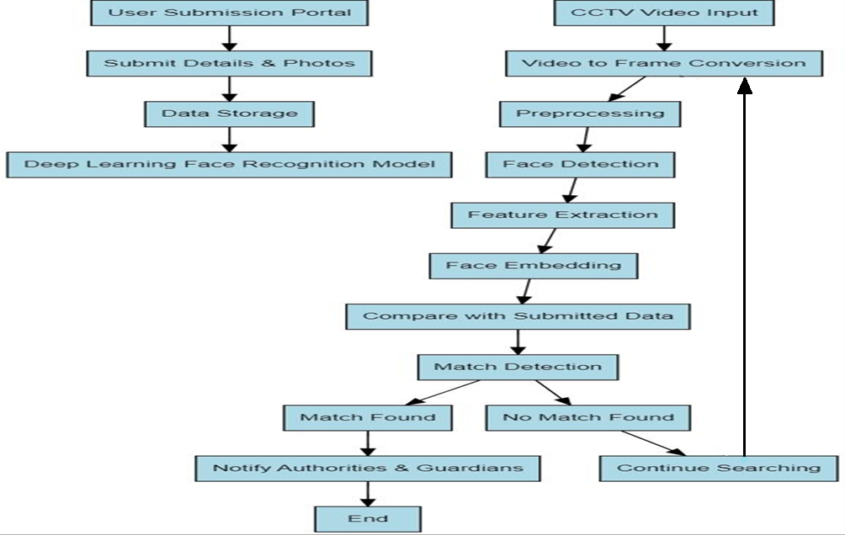
BLOCK DIAGRAM

Slide 12
Module 1: Web Portal Development
The implementation creates a user-friendly web interface to collect data about missing individuals.
The portal leverages HTML and CSS for structure and styling, ensuring accessibility and responsiveness.
In this portal, all the details of the missing person are to be filled by the applicant along with their recent photograph.
The photograph needs to be in colored format rather than black and white to ensure higher accuracy.
Validation and forms are used to ensure no information remains incomplete during submission.
Therefore, this portal helps the user and the officials to easily navigate and also enhances the search efficiency.

Slide 13
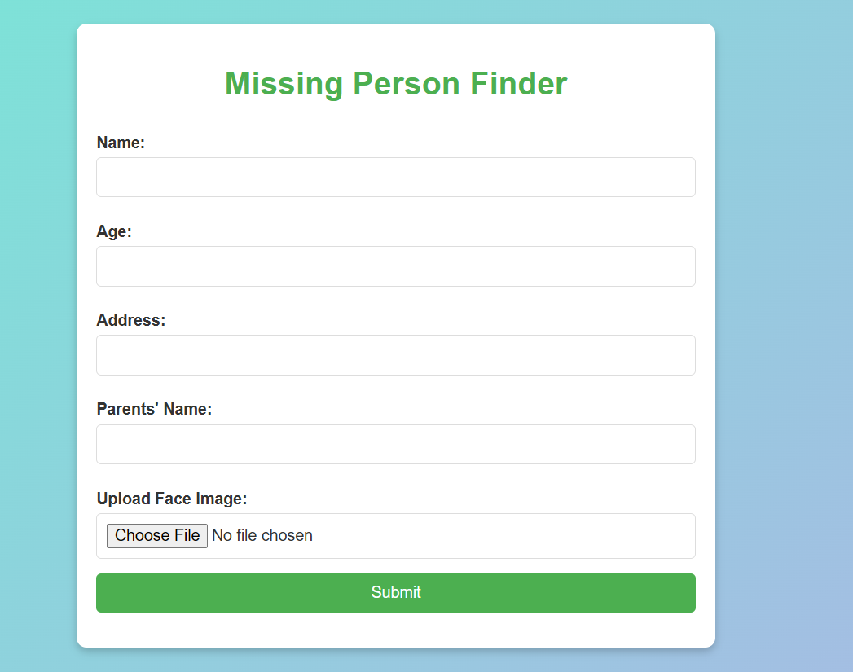
Output for Web Portal Development

Slide 14
Module 2: Video Frame Extraction
From the videos facial features are extracted where patterns are learned and these frames are saved as images.
OpenCV is used to break down the video into individual frames(for one second 72 frames are extracted) and save them locally.
These frames are resized and converted to RGB for facial detection.
Convolutional layers break the images pixel by pixel based on the image resolution and patterns learned in each layers and stored.
For face identification, Haar Cascade Classifier is used, which identifies faces by from various objects present in the videos.
Haar Cascade classifier identifies human faces and these faces are dragged ,values are separated and stored.

Slide 15
Module 2 Contd..
Once a face is detected, the dlib library refines the process by identifying 68 facial landmarks, such as the eyes, eyebrows, nose, mouth, and jawline.
These landmarks help in identifying the persons.
The frames are saved with highlighted facial features, creating a dataset that
can be used for further analysis or model training.
By combining OpenCV’s image processing with dlib’s advanced facial
recognition, the code efficiently detects and analyzes faces in videos for various applications.

Slide 16
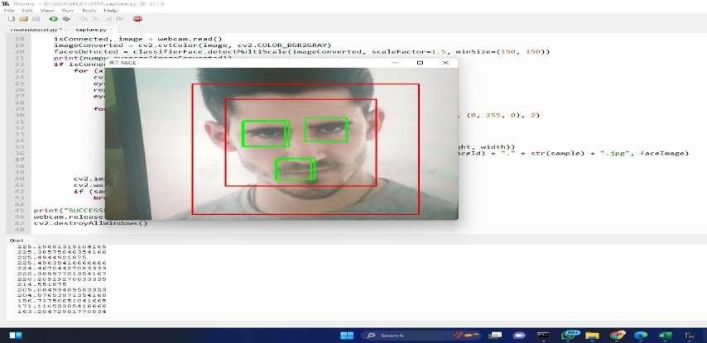
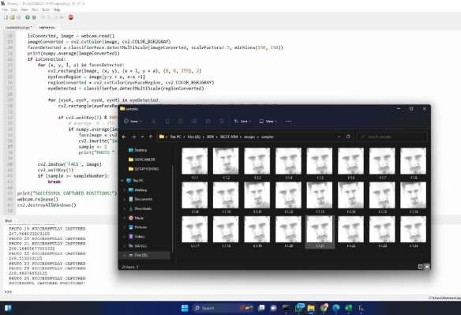

Output for converting video to frame

Slide 17
Module 3: Deep Learning Model Implementation
It utilizes the face_recognition, dlib library and cv2 (OpenCV) libraries to detect and recognize faces in real-time through a webcam.
Initially, it loads images of missing person("1.jpg" ) and encodes their facial features ( like eyes,nose, edges etc) using dlib library and it is converted into numerical data.
It has 68- point facial landmark detection which can detect the key points of the face.
These encoded faces are stored in the known_face_encodings list and associated with names (e.g, "A" ) in the known_face_names list.

Slide 18
Module 3 Contd..
A sample video is taken for the cctv video.
Theses video frames are resized and converted to RGB for face detection.
It compares these encodings against the known face encodings using compare_faces().
If a match is found, the name associated with the known face is displayed on the
screen, and a red rectangle is drawn around the detected face.
If no match is found, the system labels the face as "Unknown.“
By using this method, the system can help identify people in real-time.

Slide 19
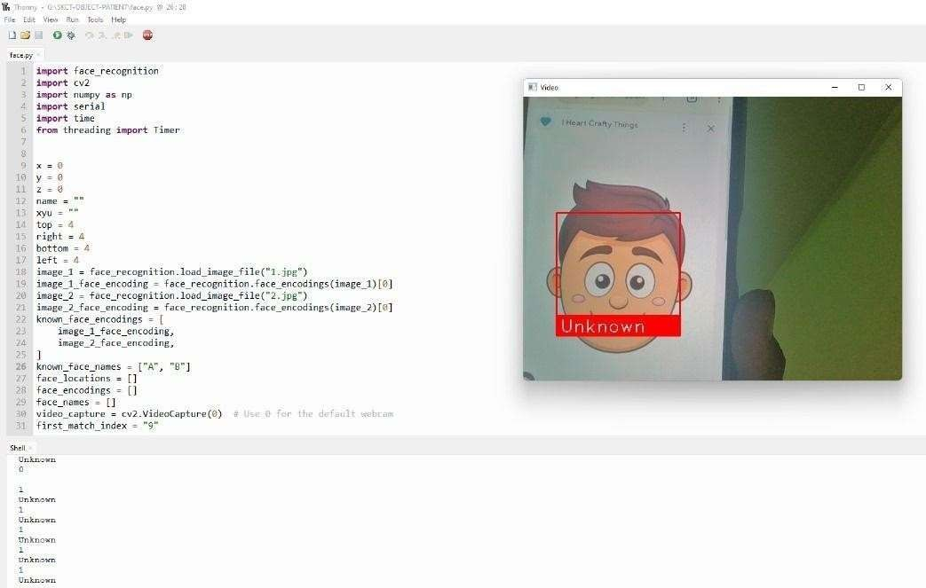

Output for facial recognition
UNKNOWN

Slide 20
Module 4: Notification System
When a match is found the portal generates a alert.
Alerts include frame details and location, sent via dashboards.
These are displayed in the alert
1.Frame Number: Identifies the video frame containing the match.
2.Similarity Score: Confidence level of the match (closer to 1.0 indicates high accuracy).
3.CCTV Frame Visualization: Displays the detected face with bounding boxes for quick verification.

Slide 21
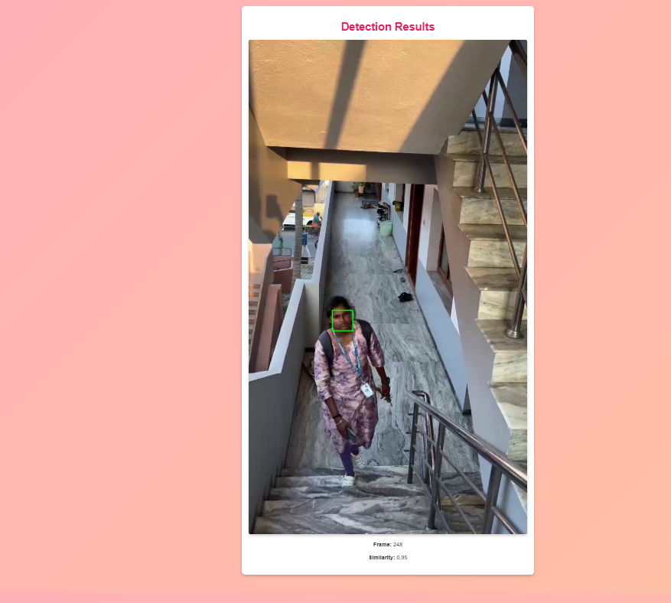
Output:
.

Slide 22
CONCLUSION
The Missing Person Finder system improves the search for missing individuals by utilizing AI and web technologies. It automates the analysis of CCTV footage through frame extraction and face recognition, greatly reducing search time and effort. The integration of deep learning models enhances the accuracy of identifying individuals in videos. It also streamlines the search process thereby increasing the chances of successful matches, ultimately facilitating quicker resolutions in missing person cases.

Slide 23
FUTURE WORK
Future enhancements include the development of age-invariant face recognition, enabling identification even as individuals age. Additionally, a more advanced notification system could integrate chatbots, SMS, WhatsApp, and email alerts for immediate reporting. These upgrades will turn the system into a real-time, scalable, and highly accurate solution for identifying missing persons, greatly enhancing law enforcement and public safety efforts.

Slide 24
REFERENCES
[1] M. Bharathwaj, K. Pravalika, Y. Keerthi, G Alekhya “Missing Child Identification using Deep learning”, 2021 IJCRT
[2] Sanskar Pawar, Lalit Bhadane, Amanullah Shaikh, Atharv Kumbhejkar, Swati Jakkan, “Find Missing Person using Artificial Intelligence”, 2021 International Research Journal of Engineering and Technology (IRJET)
[3] A. Ponmalar, B. Sandhiya, M. Bhuvaneswari, M. Gayathri, GKR Bhavana, S Aarthi, " Finding Missing Person Using Artificial Intelligence", 2022 IEEE Xplore
[4] Ms. Neha Ahirrao, Shreya Jade, Ms. Siddhi Jagtap, Prof. Namarata.D.Ghuse, Dr. Mangesh Ghonge, Dr. Amol.D.Potgantwar, “A Review on Identification of Missing Persons and Criminals using Image Processing”, 2022 International Journal of Creative Research Thoughts (IJCRT)
[5] B. Vinavatani, Medha Rachel Panna, Premila H Singha, G. Jaspher Willsie Kathrine, “AI for Detection of Missing Person”, 2022 IEEE Xplore
[6] R.Brinda, M.Bhavani, S.Ramalingam, “IoT Smart Tracking Device for Missing Person Finder (Women/Child) using ESP32 AI camera and GPS”, 2022 IEEE Xplore
[7] G. Srikanth, Adurti Swarnalatha, Thalari Abhishek, Ravula Sai Akhil Patel, Thalari Swamy, “Missing Person Identification using Machine Learning with Python”, 2022 International Journal for Research in Applied Science and Engineering Technology (IJRASET)
[8] Mayank Kumar Singh; Pooja Verma; Ajay Shanker Singh; Anandhan. K," Implementation of Machine Learning and KNN Algorithm for Finding Missing Person", 2022 IEEE Xplore
[9] Mohan Datta Inavolu, Deepa Venna, Guru Vamsi Kallepalli, Sarat Satya Surapaneni,"Detection of Missing Persons Using Mobile App", 2023 IEEE Xplore
[10] Vijaya Kaspate, Pratima Patil, Onkar Ekre, Akansha Mirgane, “Detection of Missing People using Artificial Intelligence”, 2023 Journal of Emerging Technologies and Innovative Research (JETIR)

Slide 25
REFERENCES Contd..
[11] Aditya., Ankesh Raj, Affan J., Aniket Aman, Sreevidya B.S, “Finding Missing Person Using AI”, 2023 International Journal for Research in Applied Science and Engineering Technology (IJRASET)
[12] Dr. Sharda A. Chhabria, Prof. Rahul Suryawanshi, Nivedi Dufare, Sayali Shastrakar, Omkar Ghodke, “Find Missing Person using Haar Cascade”, 2023 International Journal for Research in Applied Science and Engineering Technology (IJRASET)
[13] Ashwin Late, Jatin Natekar, Zaid Khan, Sahil Thakare, Dr. Neeraj Sharma, “Missing Person Identification System”, 2023 International Journal of Creative Research Thoughts (IJCRT)
[14] Dr.Golagani.A V R C Rao, B. Jayasri, G. Sai Sruthi, B. Rohit, D. Gowtham Sampath Sai, “Face detection and tracking to find missing person using Haarcascade algorithm”, 2023 International Journal for Research Trends and Innovation (IJRTI)
[15] Mageswaran S, Siva Kumar C, Prasanth G, Sundaram M, “Finding Missing Person Based on Face Recognition Using AI in Video Surveillance System”, 2023 International Journal for Research in Applied Science and Engineering Technology (IJRASET)
[16] Divyansh Yadav, Janhvi Tyagi, Dipanshu, Ritu Tiwari, Ms. Pawan Pandey, “Finding Missing Person/Child Using AI”, 2023 International Journal of Research Publication and Reviews
[17] Hrutika Gawas, P. K Suryawanshi, Shweta Gujarathi, Riya Gurumukhi, “AI based missing person detection with CNN”, 2024 International Research Journal of Modernization in Engineering Technology and Science (IRJMET)
[18] Shriyash Kapse, Pradip Ghadge, Vikas Virkar, Prasad Shinde, Krishna Patil, "Finding missing people using ML", 2024 International Journal of Creative Research Thoughts (IJCRT)
[19] Dr. J. Aruna Devi, Sagineti Lasya Priya, Vangalapudi Jeshitha, Sanjeevani Boddapati, Yendamuri Ganesh, Ratnala Mohan Krishna, "Locating missing persons using AI & ML", 2024 Journal of Nonlinear Analysis and Optimization
[20] Mrs Prasanna N, Pathipati Harshitha, Monali B Pipaliya, Gagan R, “Finding the Missing Person Using Artificial Intelligence”, 2024 International Journal of Scientific Research and Engineering Development

Slide 26
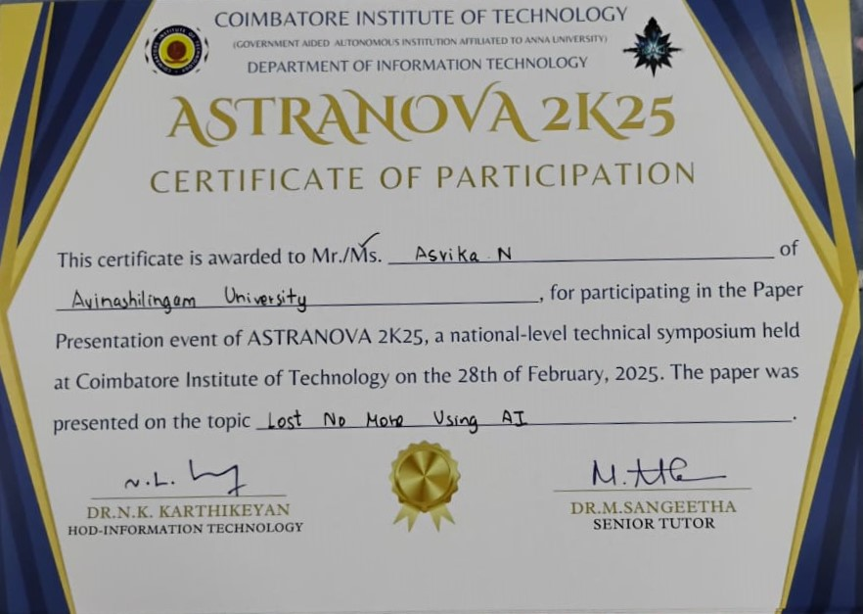
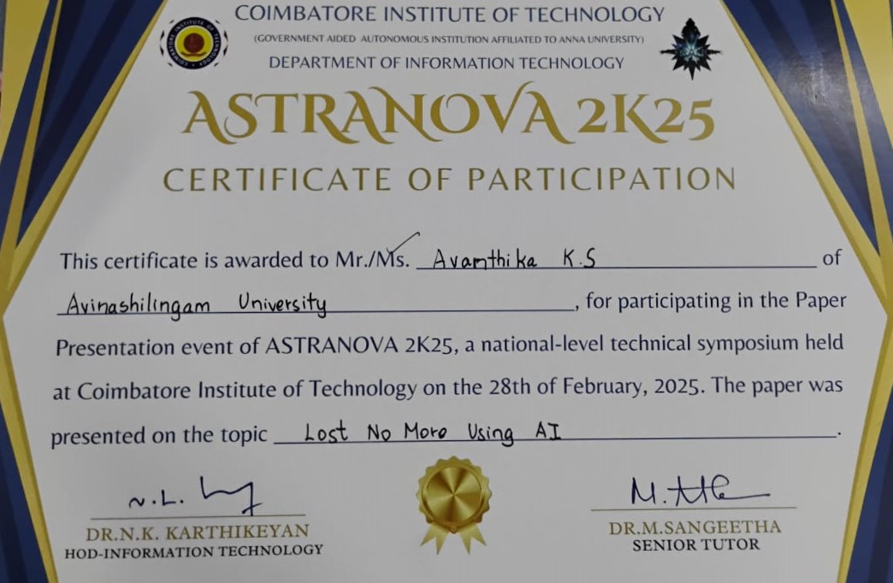
CERTIFICATES

Slide 27
THANK YOU

